Slide 1
Retrieval augmented diffusion models for time-series forecasting
Neural Networks 2024/25
21/07/2025
Valerio Baldi 1940729
Saverio Dieni 1946039

Slide 2
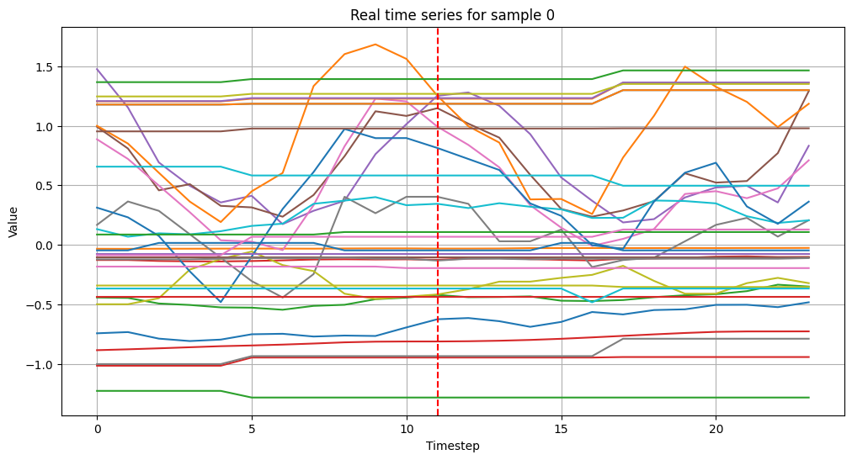
Task:
time-series forecasting
Minimization problem: find the probability distribution p parameterized by θ of having x^{P} given x^{H} that best fits the the real probability distribution
Dataset:
House price dataset HouseTS from Kaggle, we considered 34 features and took 24 timesteps series (each step of 1 month) where 12 steps were given to forecast the last 12.
Conditional Time Series Diffusion Models
Idea: in the forward process you can inject some controlled noise into the signal, then in the backward process you learn how to reconstruct the original signal.

Slide 3
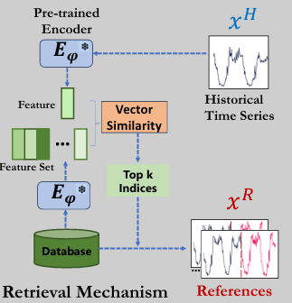
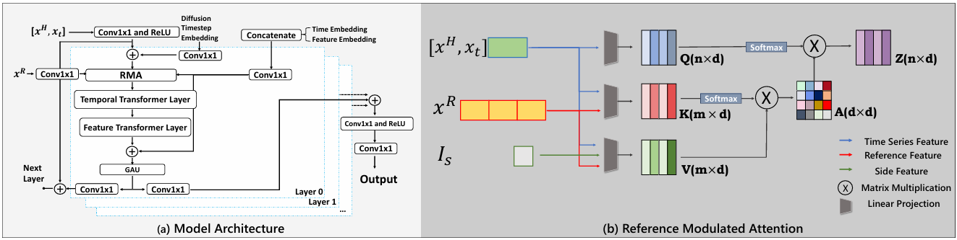
Retrieval database
There are 2 main problems in time-series generation:lack of a meaningful guidance
insufficient size
unbalance of the dataset
We embed the head of each time-series using a pre-trained autoencoder model, we build the retrieval database on the embeddings indexed with FAISS. Now we can find top k nearest neighbours based on those embeddings and take the tails of those series as a reference for the generation process.
Reference Moduled Attention (RMA)
The main novelty of the model presented in the paper is the Reference Moduled Attention (RMA) which uses the time-series references to guide the denoising process. It is an alternative to the Cross-Attention Module and it is specifically designed to exploit the references and the side information.

Slide 4
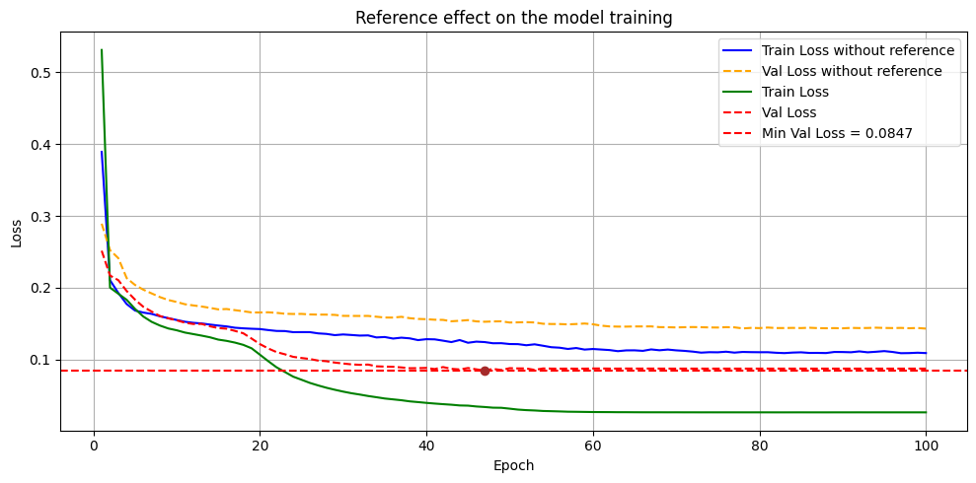
Retrieval Augmented Time series Diffusion model (RATD)
Experiment
We trained our RATD model for 100 epochs and reached a MSE on the validation dataset of 0.0847.

Slide 5
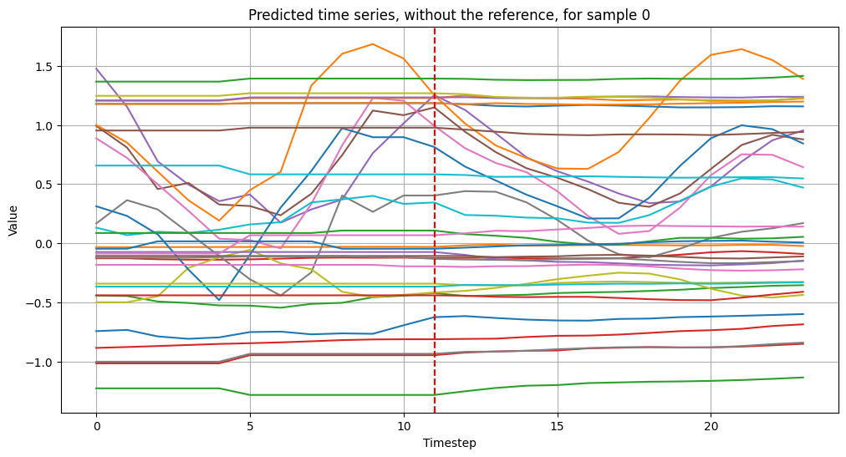
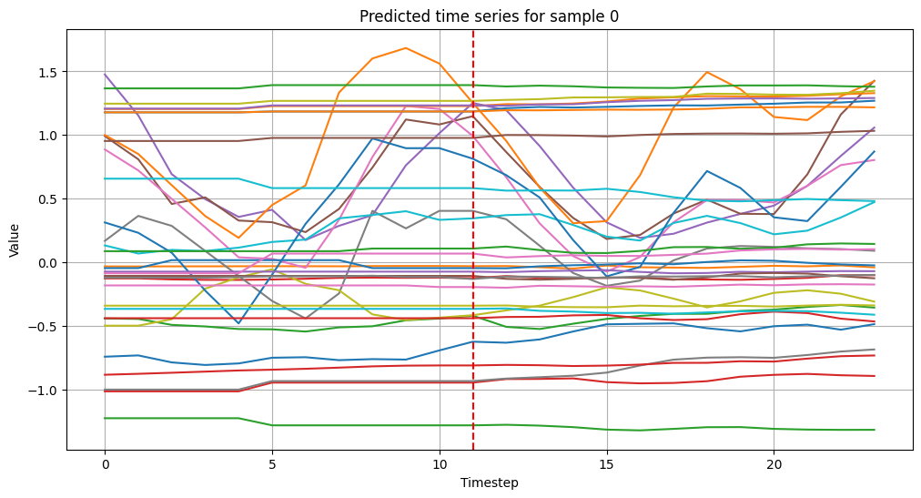
Results

Slide 6
Multimodal RATD
We expanded our RATD model by exploiting satellite images in the HouseTS dataset related to the time-series.
We used the FiLM (Feature-wise Linear Modulation) technique to integrate the images in the model.
FiLM(x | γ_{x}, β_{x}) = γ_{x} ⊙ x + β_{x}
FiLM(xr | γ_{xr}, β_{xr}) = γ_{xr} ⊙ xr + β_{xr}
where γ, β are two modulation parameter computed from an embedding y:
Concat(γ, β) = f_{ⲑ}(y)
CLIP encoder
To embed the images we used an encoder based on the pre-trained CLIP encoder, then we appropriately reshaped y to obtain the parameters γ, β.
y = CLIPEnc(img_{x})
f_{ⲑ}(y) = MLP(Conv1D(LN(y)))

Slide 7
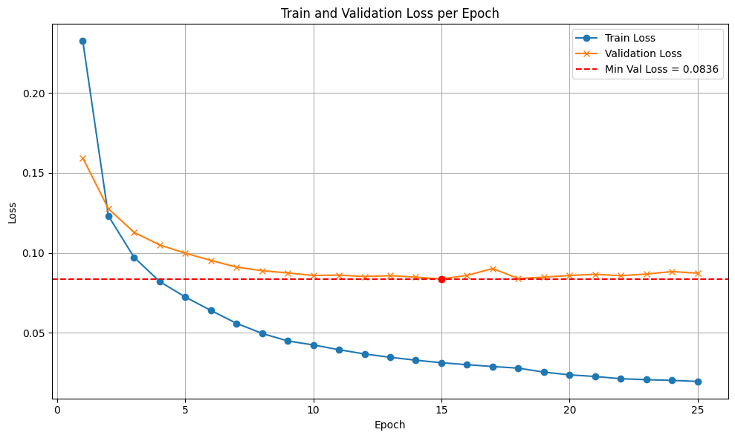
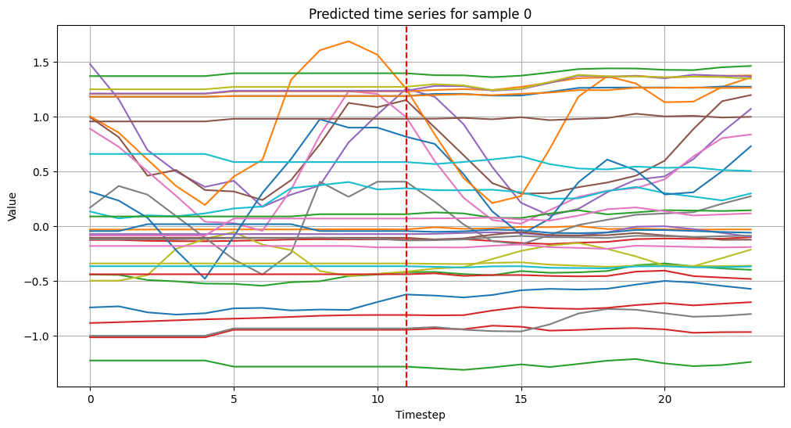
Results

